Slide 1
Improving Customer Experience
Enhancing Metro Rail Transport Using Mobile Application
Company name

Slide 2
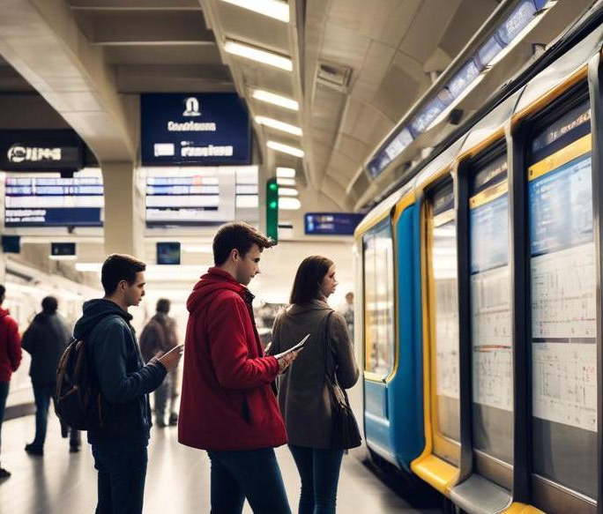
Introduction
This presentation explores the integration of a mobile application designed to improve customer experience in metro rail transport. With the growing need for efficient commuting solutions, this app addresses key challenges such as long waiting times, confusing routes, and lack of real-time updates.

Slide 3
01
App Features

Slide 4
E-ticket generation via QR
The application streamlines the ticket purchasing process by enabling users to acquire e-tickets through QR codes. This feature minimizes the wait time at ticket counters, allowing users to purchase tickets conveniently from their smartphones. Upon arriving at the metro station, passengers can swiftly board by scanning their QR codes at designated entry points, leading to a smoother travel experience.

Slide 5
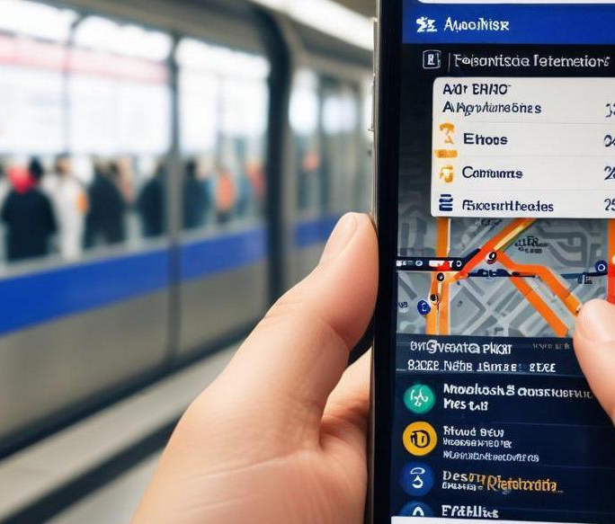
Route suggestions with ETA
To enhance navigation, the app provides users with route suggestions accompanied by estimated time of arrival (ETA). This function effectively aids commuters in planning their journeys with real-time updates on train schedules, helping them avoid delays and optimize their travel routes. Users will have access to a user-friendly interface that simplifies route selection based on proximity, travel time, and connections with other transport modes.

Slide 6
Online wallet + UPI payment
The mobile application integrates an online wallet and supports Unified Payments Interface (UPI) for seamless transactions. Users can recharge their accounts with ease, allowing for quick and efficient payments without the need for physical cash or cards. This feature encourages a contactless payment approach, enhancing customer satisfaction and safety.

Slide 7
02
Benefits

Slide 8
No need to wait in line
With the e-ticket generation through the mobile application, commuters can eliminate the need to stand in long queues at ticket counters, significantly reducing their waiting times and overall travel inconvenience.

Slide 9
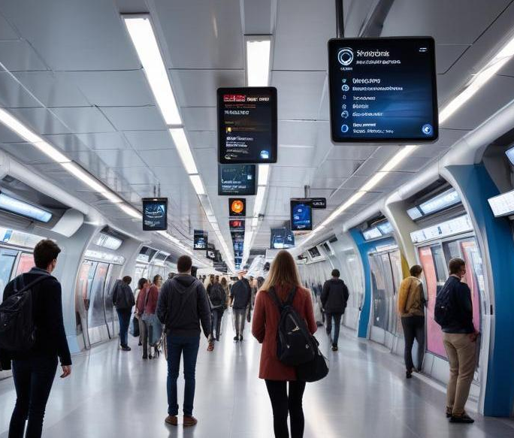
Easy to navigate stations
The application includes a user-friendly interface that provides real-time maps and navigation support, enabling passengers to easily find their way within metro stations and make informed decisions regarding their travel.

Slide 10
Convenience in recharging cards
The app facilitates easy recharging of metro cards through integrated payment options, allowing users to avoid delays and ensure they have sufficient balance before their journey.

Slide 11
Conclusions
The integration of a mobile application in metro rail transport not only revolutionizes the commuting experience for users but also positions the metro system as a modern, efficient, and user-centered solution in urban mobility. By addressing common pain points, this initiative promises to boost the overall satisfaction and adoption of metro services.

Slide 12
Thank you!
Do you have any questions?
+91 620 421 838
www.yourwebsite.com

